Slide 1
Selenium + Java Training
Trainer – Nikunj Shah

Slide 2
What is Jenkins?
Jenkins is an open source Continuous Integration server capable of orchestrating a chain of actions that help to achieve the Continuous Integration process (and not only) in an automated fashion.
Jenkins is free and is entirely written in Java. Jenkins is a widely used application around the world that has around 300k installations and growing day by day.
By using Jenkins, software companies can accelerate their software development process, as Jenkins can automate build and test at a rapid rate.
Jenkins supports the complete development lifecycle of software from building, testing, documenting the software, deploying and other stages of a software development lifecycle.

Slide 3
Download & Install Jenkins
Step 1) Got to https://jenkins.io/download/ and select the platform. In our case Windows
Step 2) Go to download location from local computer and unzip the downloaded package and install the package using .msi file
Step 3) After completing the Jenkins installation process, a browser tab will pop-up asking for the initial Administrator password. To access Jenkins, you need to go to browse the following path in your web browser.
http://localhost:8080

Slide 4
Unblock Jenkins
The initial Administrator password should be found under the Jenkins installation path (set at Step 4 in Jenkins Installation).
For default installation location to C:\Program Files (x86)\Jenkins, a file called initialAdminPassword can be found under C:\Program Files (x86)\Jenkins\secrets.
Open the highlighted file and copy the content of the initialAdminPassword file.
aste the password it into browser's pop-up tab (http://localhost:8080/login?form=%2F) and click on Continue button.

Slide 5
Configure Jenkins
Click on the "Install suggested plugins button" so Jenkins will retrieve and install the essential plugins
One can also go for Select Plugins to have customized list of plugins added to Jenkins server
Jenkins will start to download and install all the necessary plugins needed to create new Jenkins Jobs.
After all suggested plugins were installed, the "Create First Admin User" panel will show up. Fill all the fields with desired account details and hit the "Save and Finish" button.
After all suggested plugins were installed, the "Create First Admin User" panel will show up. Fill all the fields with desired account details and hit the "Save and Finish" button.

Slide 6
Configure Jenkins
Click on the "Install suggested plugins button" so Jenkins will retrieve and install the essential plugins
One can also go for Select Plugins to have customized list of plugins added to Jenkins server
Jenkins will start to download and install all the necessary plugins needed to create new Jenkins Jobs.
After all suggested plugins were installed, the "Create First Admin User" panel will show up. Fill all the fields with desired account details and hit the "Save and Finish" button.
After all suggested plugins were installed, the "Create First Admin User" panel will show up. Fill all the fields with desired account details and hit the "Save and Finish" button.

Slide 7
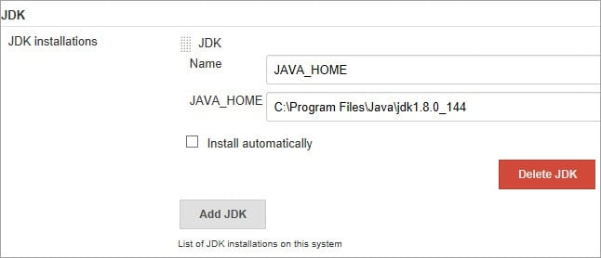
Configure Jenkins for Cucumber
Install the following plugins for Cucumber:
Cucumber Test Results plugin
Cucumber Reports
Cucumber perf plugin
Set the JDK Path and path for Maven.

Slide 8
Run Jenkins Job from Local
Create new a new freestyle Project in Jenkins
Provide the path for POM.xml file under Build section
Provide the goal as test
Give Name of Job and Save it
From the Home Screen click on Build Now
After Job is over analyze the results

Slide 9
Run Jenkins Job from Git
Create new a new freestyle Project in Jenkins
Under the Source code Management provide the .git path URL from your repository in GIT
Provide the branch name and credentials
Under build section provide the maven goal as test
Give Name of Job and Save it
From the Home Screen click on Build Now
After Job is over analyze the results

